Slide 1
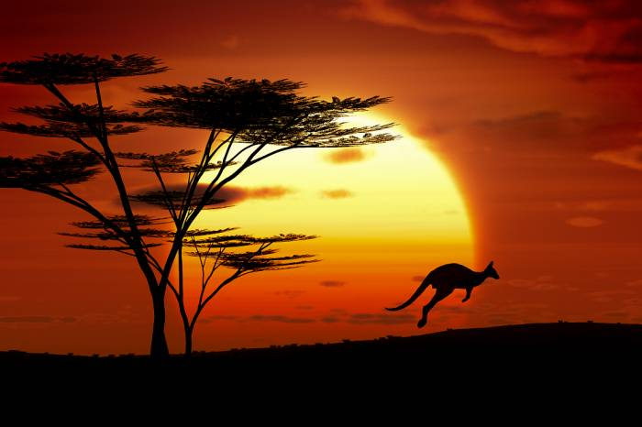
Catastrophic weather phenomena in Australia
Oliwia Moćko

Slide 2
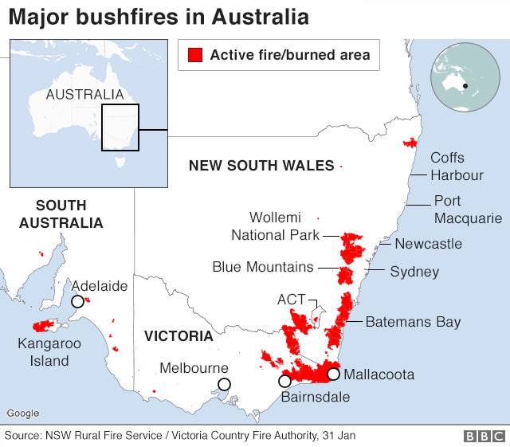
Fire in Australia
One of the largest bushfires in Australian history, which hit this country at the turn of 2019 and 2020. As a result, at least 34 people were killed. 2,500 buildings, including over 1,300 houses, were destroyed. The fire also consumed 103,000 square kilometers of bush.
New South Wales and Victoria have been worst affected
In the worst-hit state, New South Wales (NSW), fire has affected more than five million hectares, destroying more than 2,000 houses and forcing thousands to seek shelter elsewhere.

Slide 3
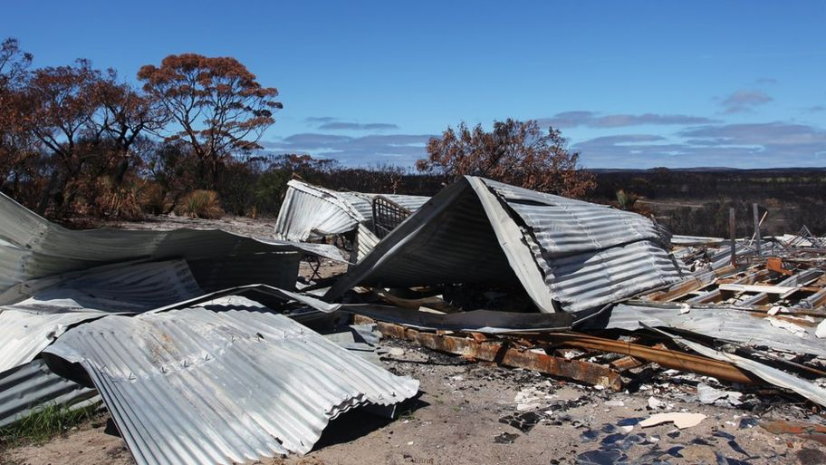
Impact on people
Thousands of people lost their homes and many had to leave their houses to live in temporary accommodation until the danger had passed.
Smoke caused big problems for people with some schools keeping pupils inside during breaks to protect them.
It was particularly hard for those with breathing problems, such as asthma, and lots of people wore face masks outside to try to avoid breathing in the smoke.
The situation was so extreme that the army was called in to help during the emergency and lots of firefighters and volunteers risked their lives tackling the flames.
Millions of Australian dollars were raised by pop stars like Chris Hemsworth, Pink and Nicole Kidman to help those affected.

Slide 4
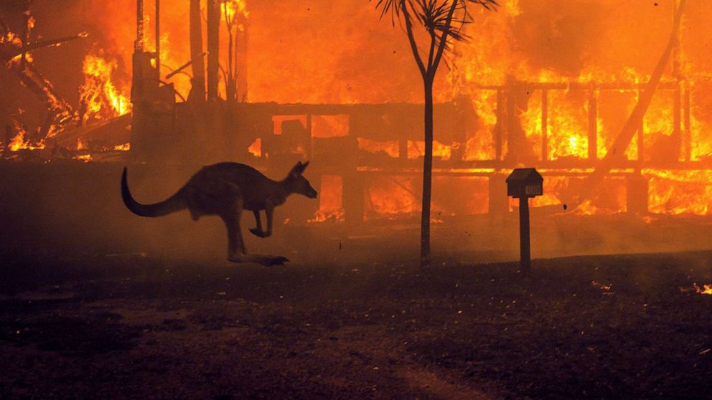
Wildlife
It's thought at least a billion animals died in the fires.
Kangaroo Island off the south of Australia was particularly badly hit with around half of the island affected by the flames.
Makeshift clinics were set up to help injured animals and the army had to be brought in to help clean up after the fires.
The loss of habitat caused further problems for the animals that survived - left struggling to find food with little shelter and more vulnerable to predators.
Some koalas from the Blue Mountains were rescued before the fires hit. They were looked after at Taronga Zoo, in Sydney, and have since been re-released into the wild.

Slide 5
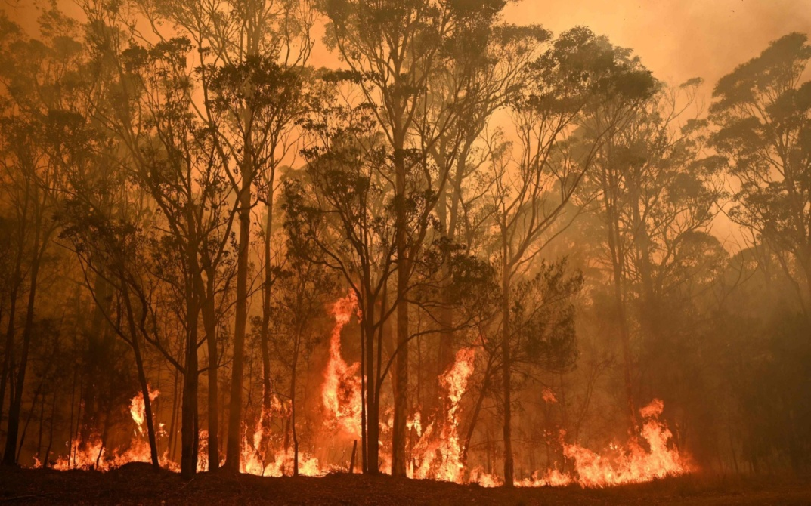
The environment
Up to 70% of the Blue Mountains National Park, a popular tourist area near Sydney, was burnt. Trees and plants have been scorched by the intense flames.
In some areas the flames reached as high as 100 metres (328 feet) tall.
Native Australian trees like eucalyptus can cope with small fires and even need heat for their seeds to be released but these fires were unusually hot and intense, causing significant damage.
The loss of trees and plants has also made flooding and landslides more likely, as roots that help hold the soil together and plants soak up rainfall have gone, meaning the earth will wash away easily - causing soil erosion.
Although most of the bush will grow back it will take several years to fully recover.

Slide 6
South Australia has also suffered
Two people and an estimated 25,000 koalas were killed when flames devastated Kangaroo Island in the state of South Australia on 9 January. The island is renowned for its unique mix of animal species - and there are fears it may never recover.
Experts have expressed concerns over the survival of endangered species on the island which include the dunnart - a mouse-like marsupial - and the black glossy cockatoo. Tens of thousands of farm animals, mainly sheep, were also killed in the fire on the island. Elsewhere in South Australia, the Cudlee Creek fire is reported to have destroyed more than 80 homes in the Adelaide Hills region in late December.
Fires are also thought to have destroyed up to a third of the vines that provide grapes for the Adelaide Hills wine industry.

Slide 7
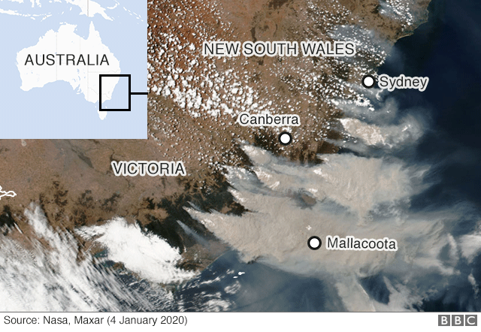
Smoke from fires has become a major hazard
Canberra has seen some of the worst smoke pollution, with air quality rated the third worst of all major global cities on 3 January, according to Swiss-based group AirVisual. Satellite images from 4 January showed the spread of smoke from fires in Victoria and NSW, which has affected air quality as far away as New Zealand.

Slide 8
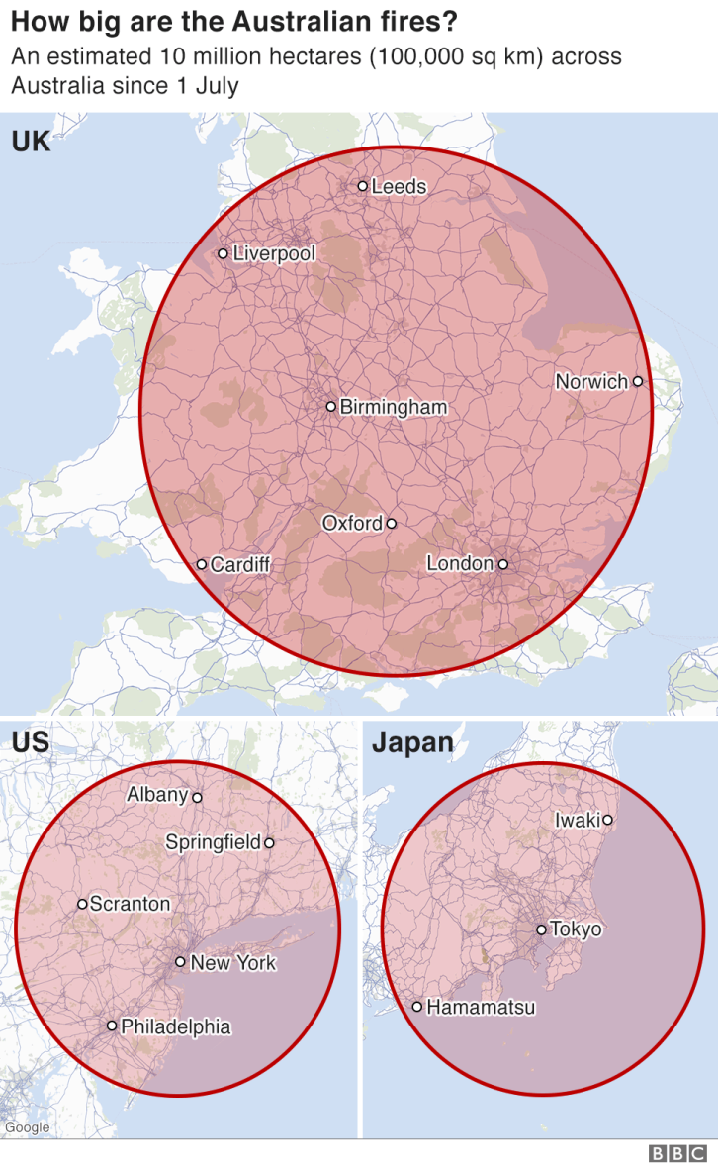
The fires have been worse than usual
Although Australia has always had bushfires, this season has been worse than usual.The amount of land affected across the country - more than 10 million hectares - is now comparable to England's land area of 13 million hectares.
Humans are sometimes to blame for starting the fires, but they are also often sparked by natural causes, such as lightning striking dry vegetation.
Once fires have started, other areas are at risk, with embers blown by the wind causing blazes to spread to new areas.
Bush fires themselves can also drive thunderstorms, increasing the risk of lightning strikes and further fires.

Slide 9
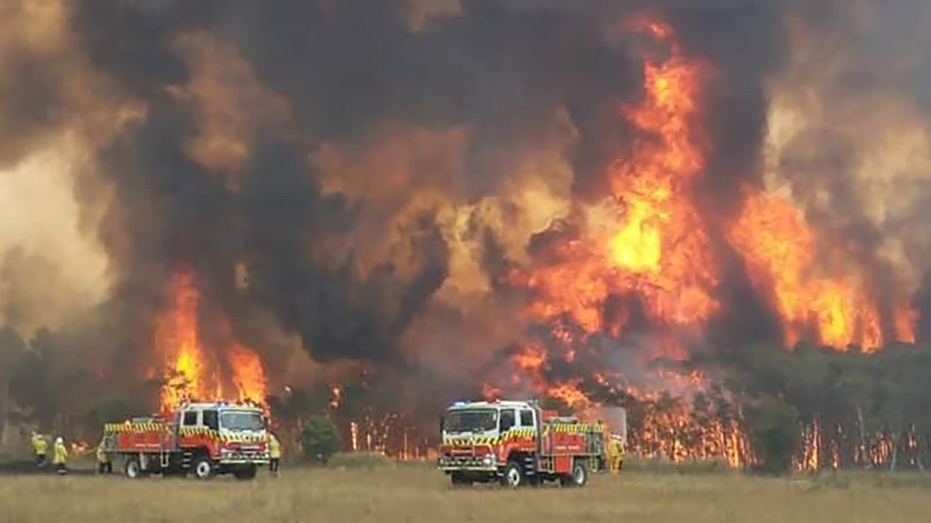
How climate scientists 'predict the future'
Climate models - simulations that use all available information about what drives our planet's climate - are the primary method we have to understand what will happen as Earth warms.
They are extremely good at modelling certain aspects of the climate, particularly global temperature patterns, but fire is much more complicated. It is affected by many factors, including rainfall, wind, land cover and population density - everything that increases the risk of fire, fuels and spreads it.

Slide 10
Thank you for your attention

